Slide 1
A example for VLA data reduction in CASA
3c391 a supernova remnat
Lv Bing

Slide 2
Observational logs
There is no C-band receivers on ea13 Antenna ea06 is out of the array Antenna ea15 has some corrupted data Antennas ea10, ea12, ea22 do not have good baseline positions Gusty winds, mixed clouds, API rms up to 11.5.
http://www.vla.nrao.edu/cgi-bin/oplogs.cgi

Slide 3
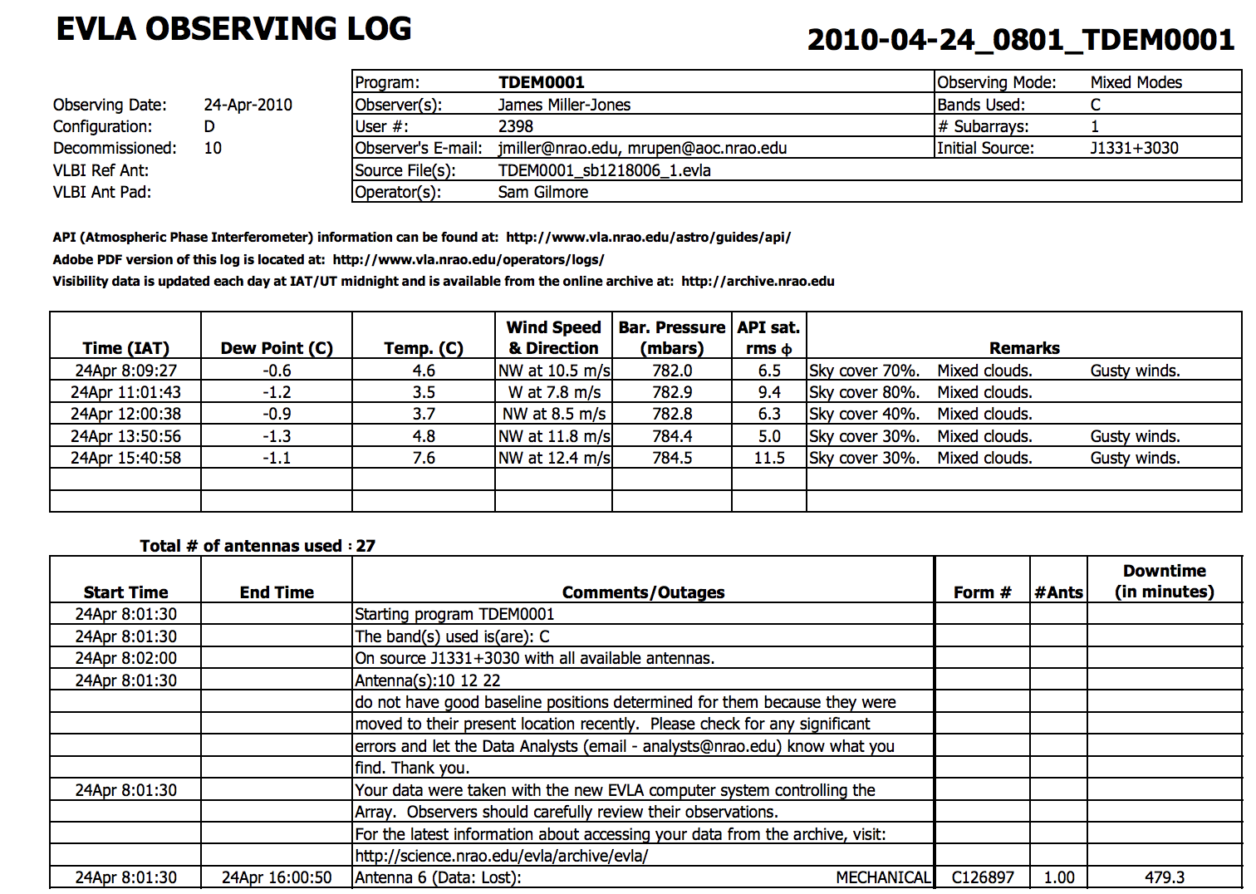

Slide 4
Download and view the data
https://archive.nrao.edu/archive/advquery.jsp
# In a Terminal:
tar xzvf 3c391_ctm_mosaic_10s_spw0.ms.tgz
# In casa
listobs(vis='3c391_ctm_mosaic_10s_spw0.ms')
plotants(vis='3c391_ctm_mosaic_10s_spw0.ms',figfile='plotants_3c391_antenna_layout.png')
clearstat() # This removes the table lock generated by plotants in script mode
* 4.6GHz and 7.5GHz bandwidth 128MHz
select an antenna that is close to the center of the array as a reference,
e.g.ea21 here

Slide 5
Calibrator
* J1331+3030 = 3C 286, which will later serve as a calibrator for the visibility amplitudes, i.e., it is assumed to have a precisely known flux density; the spectral bandpass; and the polarization position angle;
* J1822-0938, which will serve as a calibrator for the visibility phases;
* J0319+4130 = 3C 84, which will serve as a polarization calibrator; and
* 3C391 C1&#150;C7, which are 7 fields centered on and surrounding the supernova remnant.

Slide 6
Flagdata
flagdata(vis='3c391_ctm_mosaic_10s_spw0.ms', flagbackup=True, mode='manual', scan='1')
flagdata(vis='3c391_ctm_mosaic_10s_spw0.ms', flagbackup=True, mode='manual', antenna='ea13,ea15')
flagdata(vis='3c391_ctm_mosaic_10s_spw0.ms', mode='quack', quackinterval=10.0, quackmode='beg')

Slide 7
Calibration
Antenna Position Corrections antpos gaincal
Initial Flux Density Scaling intensity Calibrator model setjy
Initial phase calibration phase gaincal
Delay Calibration delays relative to the reference antenna gaincal
Bandpass Calibration channel bandpass
Gain Calibration
Polarization Calibration
instrumental polarization polcal
R-L polarization angle
Scaling the Amplitude Gains fluxscale

Slide 8
Polarization
# In CASA
i0=7.6677 # Stokes I value for spw 0 ch 0
c0=0.112 # Fractional polarization=11.2%
d0=33*pi/180 # polarization angle of 33 degrees converted to radians
setjy(vis='3c391_ctm_mosaic_10s_spw0.ms', field='J1331+3030', standard='manual', spw='0', fluxdensity=[i0,0,0,0], spix=[alpha,0], reffreq='4536.0MHz', polindex=[c0,0], polangle=[d0,0], scalebychan=True, usescratch=False)

Slide 9
Applying the Calibration
# In CASA
applycal
# In CASA split(vis='3c391_ctm_mosaic_10s_spw0.ms',outputvis='3c391_ctm_mosaic_spw0.ms', datacolumn='corrected',field='2~8')

Slide 10
Initial Imaging
# In CASA plotms(vis=‘3c391_ctm_mosaic_spw0.ms’,xaxis=‘uvwave’,yaxis=‘amp’, ydatacolumn=‘data’, field=‘0’,avgtime=‘30’,correlation=‘RR’, plotfile=‘plotms_3c391-mosaic0-uvwave.png’,overwrite=True)

Slide 11
Clean
clean(vis=‘3c391_ctm_mosaic_spw0.ms’, imagename=‘3c391_ctm_spw0_I’, field=‘’,spw=‘’, mode=‘mfs’, niter=5000, gain=0.1, threshold=‘1.0mJy’, psfmode=‘clark’, imagermode=‘mosaic’, ftmachine=‘mosaic’, multiscale=[0], interactive=True, imsize=[480,480], cell=[‘2.5arcsec’,‘2.5arcsec’], stokes=‘I’, weighting=‘briggs’,robust=0.5, usescratch=False)
viewer('3c391_ctm_spw0_I.image')

Slide 12
Advanced Topic Multi-scale Polarization Clean
clean(vis='3c391_ctm_mosaic_spw0.ms',imagename='3c391_ctm_spw0_IQUV', field='',spw='', mode='mfs', niter=25000, gain=0.1, threshold='1.0mJy', psfmode='clarkstokes', imagermode='mosaic', ftmachine='mosaic', multiscale=[0, 6, 18, 54], smallscalebias=0.9, interactive=True, imsize=[480,480], cell=['2.5arcsec','2.5arcsec'], stokes='IQUV', weighting='briggs',robust=0.5, pbcor=False, usescratch=False)
multiscale=[0, 6, 18, 54], smallscalebias=0.9 : A multi-scale cleaning algorithm is used because the supernova remnant contains both diffuse, extended structure on large spatial scales and finer filamentary structure on smaller scales. The settings for multiscale are in units of pixels, with 0 pixels equivalent to the traditional delta-function clean.

Slide 13
Image Analysis and Manipulation
impbcor(imagename='3c391_ctm_spw0_IQUV.image',pbimage='3c391_ctm_spw0_IQUV.flux',outfile='3c391_ctm_spw0_IQUV.pbcorimage')
viewer('3c391_ctm_spw0_IQUV.pbcorimage')
Primary beam correction

Slide 14
Constructing Polarization Intensity and Angle Images
Extract the I, Q, U, V planes
imsubimage(imagename='3c391_ctm_spw0_IQUV.image',outfile='3c391_ctm_spw0.I',stokes='I') imsubimage(imagename='3c391_ctm_spw0_IQUV.image',outfile='3c391_ctm_spw0.Q',stokes='Q') imsubimage(imagename='3c391_ctm_spw0_IQUV.image',outfile='3c391_ctm_spw0.U',stokes='U') imsubimage(imagename='3c391_ctm_spw0_IQUV.image',outfile='3c391_ctm_spw0.V',stokes='V')
We also extract a pb-corrected I image for later use:
imsubimage(imagename='3c391_ctm_spw0_IQUV.pbcorimage',outfile='3c391_ctm_spw0.pbcorI',stokes='I')

Slide 15
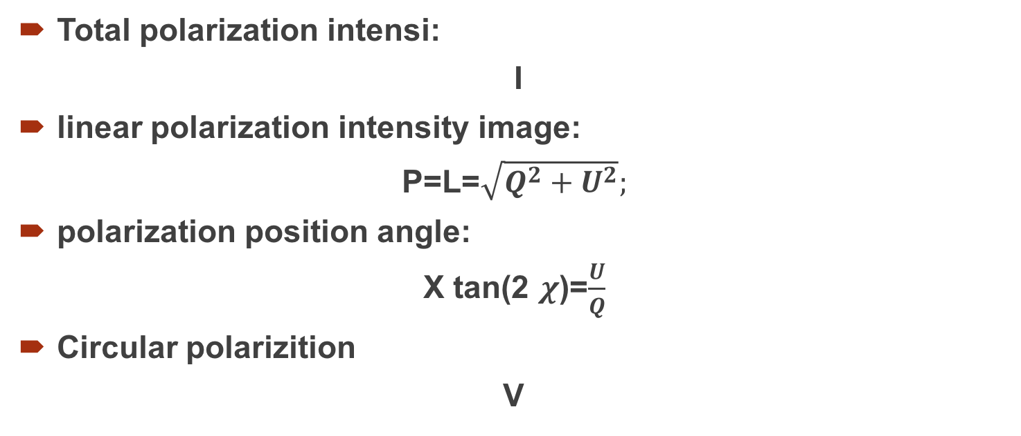
Stokes parameters: I, Q, U, and V.
Total polarization intensi:
I
linear polarization intensity image:
P=L=$\sqrt{Q^{2}+U^{2}};$
polarization position angle:
X tan(2 $χ$)=$\frac{U}{Q}$
Circular polarizition
V

Slide 16
how the polarized emission relates to the total intensity, and how the magnetic field is structured
viewer('3c391_ctm_spw0.pbcorP')
load the pb-corrected total intensity image as a contour image
load the polarization position angle image

Slide 17
The polarization position angle as calculated is the electric vector position angle (EVPA)
If we are interested in the orientation of the magnetic field, then for an optically thin source , the magnetic field orientation is perpendicular to the EVPA, so we must rotate the vectors by 90∘90∘

Slide 18
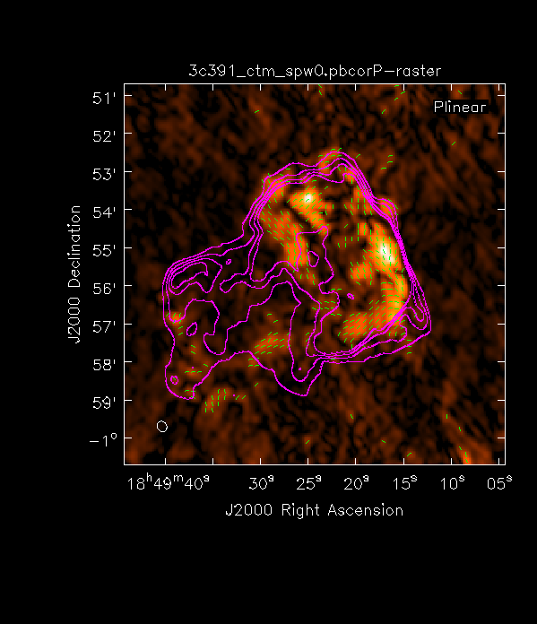

Hotmetel:P
magenta:I
Green:X

Slide 19
Spectral Index Imaging
Index=log(Sν1/Sν2)/log(ν1/ν2)

Slide 20
Self-Calibration
Even after the initial calibration using the amplitude calibrator and the phase calibrator, there are likely to be residual phase and/or amplitude errors in the data.

Slide 21
Next
Another spectrum window and other sources
How to deal with RFI
Faraday rotation and rotation measure
Point source?

